Slide 1
CHAPTER 6: Sequential Logic Circuit Design

Slide 2
Syllabus
Week | Content | Notes
1 | Chapter 0: Course Introduction (1) Chapter 1: Introduction to Digital Design (2)
2 | Chapter 2: Overview of HDL (3)
3 | Chapter 3: Basic Language Constructs of VHDL (3)
4, 5 | Chapter 4: Signal Assignment Statements of VHDL (6)
6 | Chapter 5: Combinational Logic Circuit Design (3)
7 | Midterm Exam (2)
8 | Chapter 6: Sequential Logic Circuit Design (3)
9, 10 | Chapter 7: Finite State Machine (FSM) Principle (6)

Slide 3
Content
Overview of Sequential Circuits
Synchronous Circuits
Inference of Basic Memory Elements
Simple Design Examples
Timing Analysis of A Synchronous Sequential Circuits

Slide 4
1. Overview of Sequential Circuits
A combinational circuit, by definition, is a circuit whose output, after the initial transient period, is a function of current input.
It has no internal state and therefore is “memoryless” about the past events (or past inputs).
A sequential circuit, on the other hand, has an internal state, or memory.
Its output is a function of current input as well as the internal state.

Slide 5
1. Overview of Sequential Circuits
The internal state essentially “memorizes” the effect of the past input values.
The output thus is affected by current input value as well as past input values (or the entire sequence of input values).
That is why we call a circuit with internal state is a sequential circuit.
These elements can be divided into two broad categories: latch and flip-flop (FF).
We review the basic characteristics of a D-type latch (or just D latch) and D-type FF (or just D-FF).

Slide 6
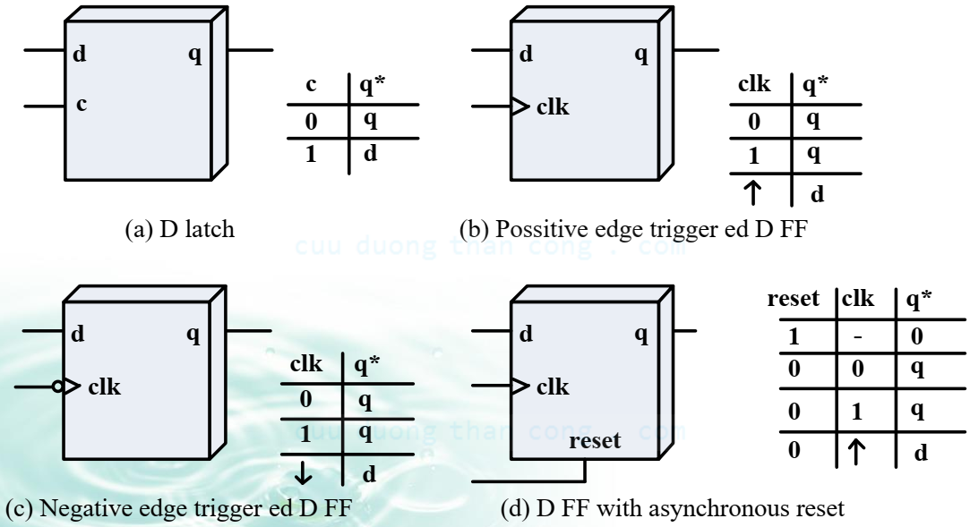
1. Overview of Sequential Circuits

Slide 7
1. Overview of Sequential Circuits
The clock signal of FFs plays a key role sequential circuit design.
According to the arrangement of the clock, we can divide the sequential circuits into the following classes:
  Globally synchronous circuit (or simply synchronous circuit)
  Globally asynchronous locally synchronous circuit
  Globally asynchronous circuit

Slide 8
1. Overview of Sequential Circuits
Globally asynchronous locally synchronous circuit
Sometimes physical constraints, such as the distance between components, prevent the distribution of a single clock signal.
In this case, a system may be divided into several smaller sybsystems.
Since a subsystem is smaller, it can follow the synchronous design principle.
Thus, subsystems are synchronous internally.
Since each subsystem utilizes its own clock, operation between the subsystems is asynchronous.

Slide 9
1. Overview of Sequential Circuits
Globally asynchronous circuit
A globally asynchronous circuit does not use a clock signal to coordinate the memory operation.
The state of a memory element changes independently.
Globally asynchronous circuits can be divided into two categories.

Slide 10
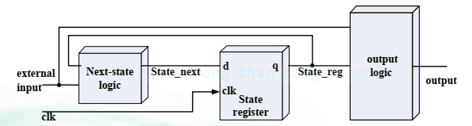
2. Synchronous Circuits
The basic diagram of a synchronous circuit is shown as
The memory element, frequently known as state register, is a collection of D-FFs, synchronized by a common global clock signal.
The output of the register (i.e., the content stored in the register), the State_reg signal, represents the internal state of the system.

Slide 11
2. Synchronous Circuits
The Next-state logic is a combinational circuit that determines the next state of the system.
The output logic is another combinational circuit that generates the external output signal.
Note that the output depends on the external input signal and the current state of the register.

Slide 12
2. Synchronous Circuits
The circuit operates as follows:
At the edge of the clock (rising or falling), the value of the State_next signal (appearing at the d port) is sampled and propagated to the q port, which becomes the new value of the State_reg signal.
The value is also stored in FFs and remains unchanged for the rest of the clock period. It represent the current state of the system.

Slide 13
2. Synchronous Circuits
Based on the value of the State_reg signal and external input, the Next-state logic computes the value of the State_next signal the output logic computes the value of external output.
At the next edge of the clock, the new value of the State_next signal is sampled and the State_reg signal is updated.
The process then repeats.

Slide 14
2. Synchronous Circuits
To satisfy the timing constraints of the FFs, the clock period must be large enough to accommodate the propagation delay of the Next-state logic, the clock-to-q delay of the FFs and the setup time of the FFs.
There are several advantages of synchronous design.
First, it simplifies circuit timing.
Satisfying the timing constraints (i.e., avoiding setup time and hold time violation) is one of the most difficult design tasks.
When a circuit has hundreds or even thousands of FFs and each FF is driven by an individual clock, the design and analysis will be overwhelming.

Slide 15
2. Synchronous Circuits
When a circuit has hundreds or even thousands of FFs and each FF is driven by an individual clock, the design and analysis will be overwhelming.
Since in a synchronous circuit, all FFs are driven by the identical clock signal, the sampling of the clock edge occurs simultaneously.
We only need to consider the timing constraints of a single memory component.

Slide 16
2. Synchronous Circuits
Second, the synchronous model clearly separates the combinational circuits and the memory elements.
We can easily isolate the combinational part of the system, and design and analyze it as a regular combinational circuit.
Third, the synchronous design can easily accommodate the timing hazards.
The timing hazards are unavoidable in a large synthesized combinational circuit.
Instead of considering all the possible timing scenarios, we only need to focus on the worst-case propagation delays of the combinational circuit.

Slide 17
2. Synchronous Circuits
Based on the “representation and transition pattern” of state, we divide synchronous circuits into three types.
These divisions are informal, just for clarity of coding.
There types are:
  Regular sequential circuit
  Random sequential circuit
  Combined sequential circuit

Slide 18
2. Synchronous Circuits
Regular sequential circuit
The state representation and state transitions have a simple, regular pattern, as in a counter and a shift register.
Similarly, the next-state logic can be implemented by regular, structural components, such as an incrementor and shifter.
Random sequential circuit
The state transitions are more complicated and there is no special relation between the states and their binary representations.
The next-state logic must be constructed from scratch (i.e., by random logic).
This kind of circuit is known as a finite state machine (FSM).

Slide 19
2. Synchronous Circuits
Combined sequential circuit
A combined sequential circuit consists of both regular sequential circuit and an FSM.
The FSM is used to control operation of the regular sequential circuit.
This kind of circuit is based on the register transfer methodology and is sometimes known as finite state machine with data path (FSMD).
We will discuss the design and description of FSM and FSMD in next Chapter.

Slide 20
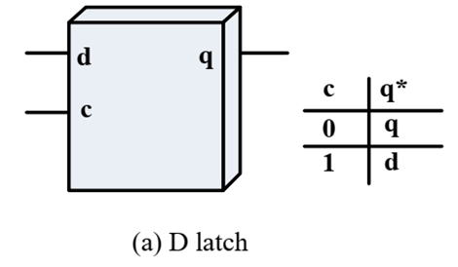
3. Inference of Basic Memory Elements
The function table of a D latch was shown in Figure.
It is the standard description.
Synthesis software should infer a predesigned D latch from the device library.

Slide 21
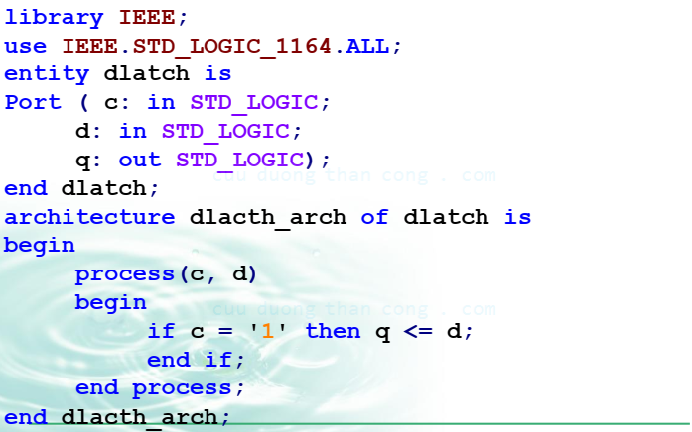
3. Inference of Basic Memory Elements
The corresponding VHDL code of D latch

Slide 22
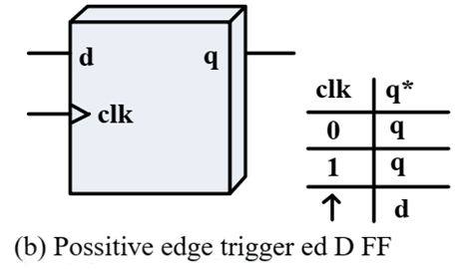
3. Inference of Basic Memory Elements
Positive-edge-triggered DFF
This is a standard description and should be recognized by all synthesis software.
A predefined D-FF should be inferred accordingly.

Slide 23
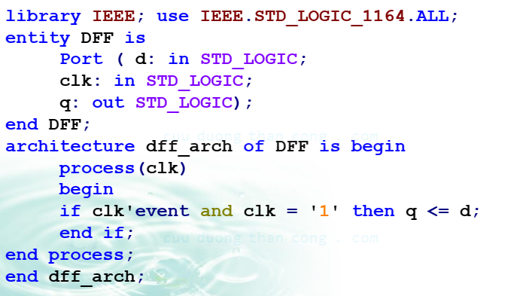
3. Inference of Basic Memory Elements
The corresponding VHDL code of positive-edge-triggered DFF

Slide 24
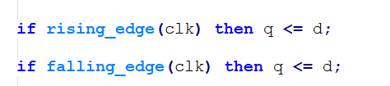
3. Inference of Basic Memory Elements
We can also add an extra condition clk’last_value = ‘0’ to the Boolean expression
It becomes:
The above Boolean expression is defined as a function, rising_edge(clk), falling_edge(clk) in the IEEE std_logic_1164 package.

Slide 25
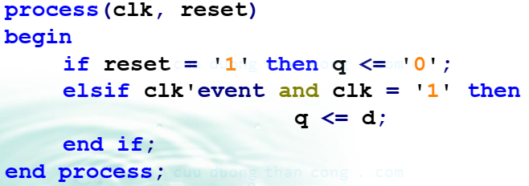
3. Inference of Basic Memory Elements
D-FF with asynchronous reset

Slide 26
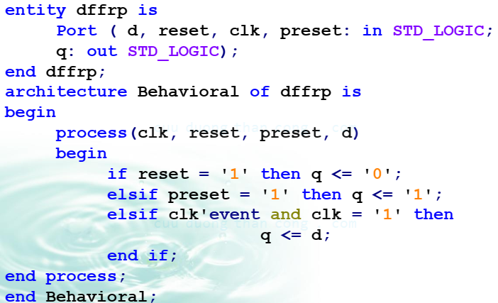
3. Inference of Basic Memory Elements
D-FF with asynchronous reset and preset

Slide 27
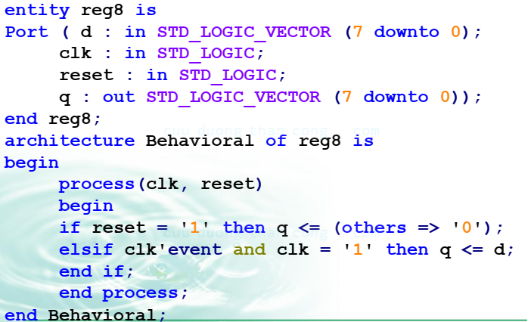
3. Inference of Basic Memory Elements
A register is a collection of a D-FFs that is driven by the same clock and reset signals. The VHDL code of 8-bit register

Slide 28
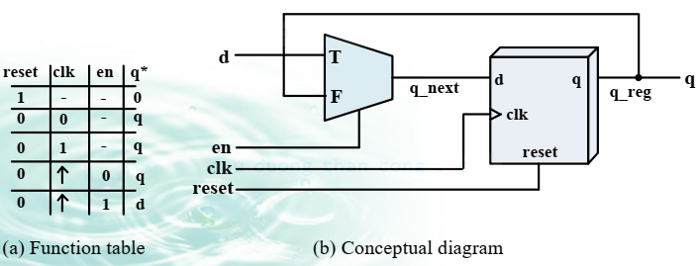
4. Simple Design Examples
Consider a D-FF with additional enable signal
Note that the enable signal, en, has an effect only at the rising edge of the clock.
This means that the signal is synchronized to the clock.

Slide 29
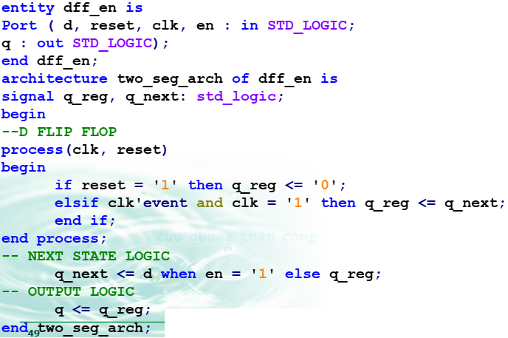
4. Simple Design Examples
The VHDL code

Slide 30
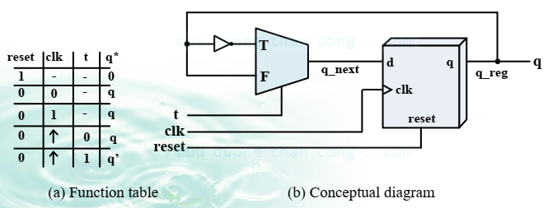
4. Simple Design Examples
Consider a T-FF has a control signal, t, which specifies whether the FF to invert (i.e., toggle) its content.

Slide 31
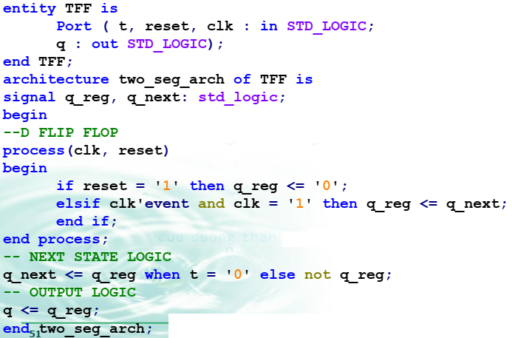
4. Simple Design Examples
The VHDL code

Slide 32
4. Simple Design Examples
Shift Register – free running shift-right register
A shift register shifts the content of the register left or right 1 bit in each clock cycle.
One major application of a shifter register is to send parallel data through a serial line.
At the transmitting end, a data word is first loaded to register in parallel and is then shifted out 1 bit at a time.
In the receiving end, the data word is shifted in 1 bit at a time and reassembled.
A free-running shift register performs the shifting operation continuously.

Slide 33
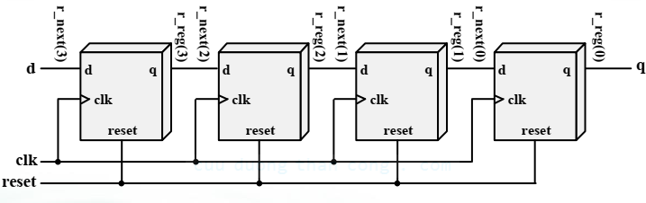
4. Simple Design Examples
A free-running shift register performs the shifting operation continuously.
It has no other control signals. A 4-bit free running shift-right register is shown as:

Slide 34
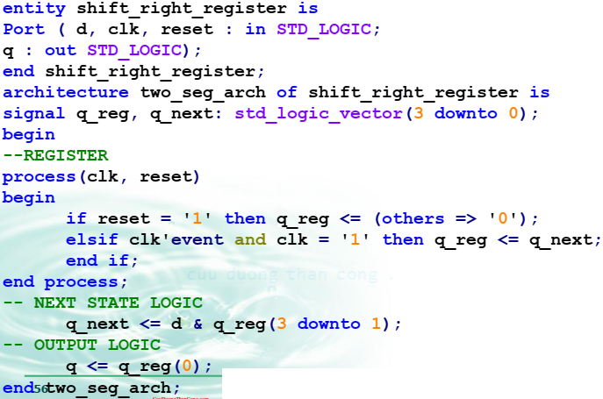
4. Simple Design Examples
The VHDL code

Slide 35
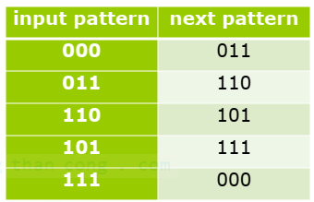
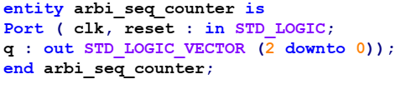
4. Simple Design Examples
Arbitrary-sequence counter
A sequential counter circulates a predefined sequence of states.
The next-state logic determines the patterns in the sequence.

Slide 36
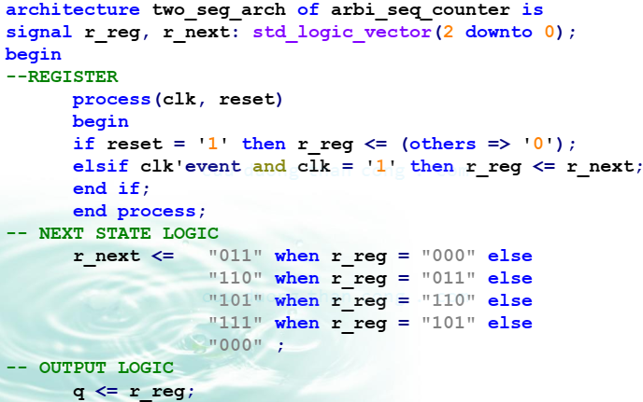
4. Simple Design Examples

Slide 37
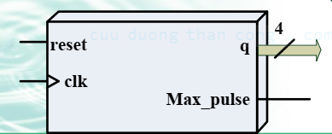
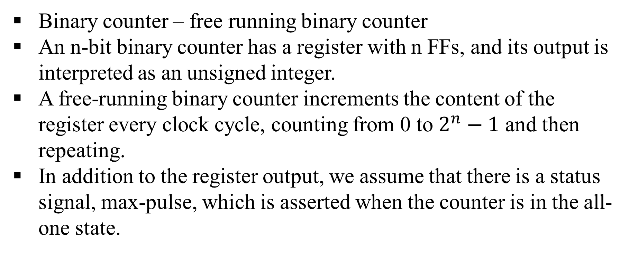
4. Simple Design Examples
Binary counter – free running binary counter
An n-bit binary counter has a register with n FFs, and its output is interpreted as an unsigned integer.
A free-running binary counter increments the content of the register every clock cycle, counting from 0 to $2^{n}−1$ and then repeating.
In addition to the register output, we assume that there is a status signal, max-pulse, which is asserted when the counter is in the all-one state.

Slide 38
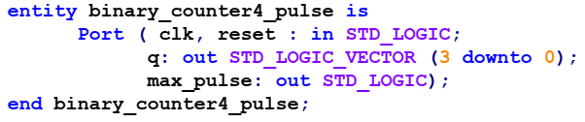
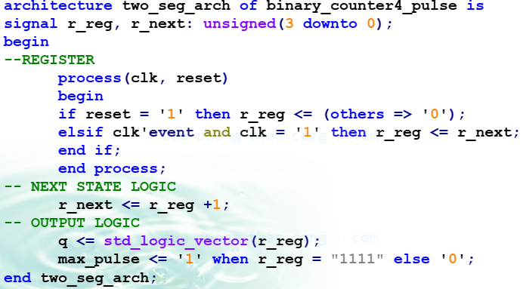
4. Simple Design Examples

Slide 39
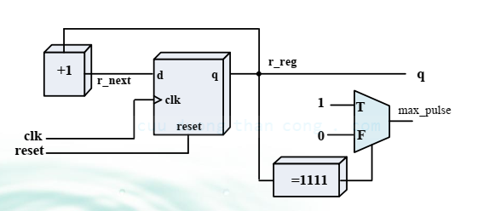
4. Simple Design Examples

Slide 40
4. Timing Analysis of A Sequential Circuits
Binary counter – free running binary counter
An n-bit binary counter has a register with n FFs, and its output is interpreted as an unsigned integer.
A free-running binary counter increments the content of the register every clock cycle, counting from 0 to $2^{n}−1$ and then repeating.
In addition to the register output, we assume that there is a status signal, max-pulse, which is asserted when the counter is in the all-one state.

